Slide 1
Measurement of Three Phase Power: Three Wattmeter Method

Slide 2
Power measurement in an AC circuit is measured with the help of a Wattmeter.
A wattmeter is an instrument which consists of two coils called Current coil and Potential coil.
The current coil having low resistance is connected in series with the load so that it carries the load current.
The potential coil having the resistance is connected across the load and carries the current proportional to the potential difference.

Slide 3
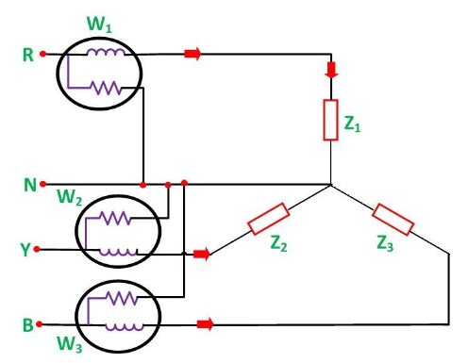
Three Wattmeter method is employed to measure power in a 3 phase, 4 wire system. However, this method can also be employed in a 3 phase, 3 wire delta connected load, where power consumed by each load is required to be determined separately.

Slide 4

The pressure coil of all the three wattmeters namely W₁, W₂ and W₃ are connected to a common terminal known as the neutral point. The product of the phase current and line voltage represents phase power and is recorded by an individual wattmeter.
The total power in a three wattmeter method of power measurement is given by the algebraic sum of the readings of three wattmeters. i.e.
W₁ = V₁I₁
W₂ = V₂I₂
W₃ = V₃I₃
Except for 3 phase, 4 wire unbalanced load, 3 phase power can be measured by using only Two Wattmeter Method.

Slide 5
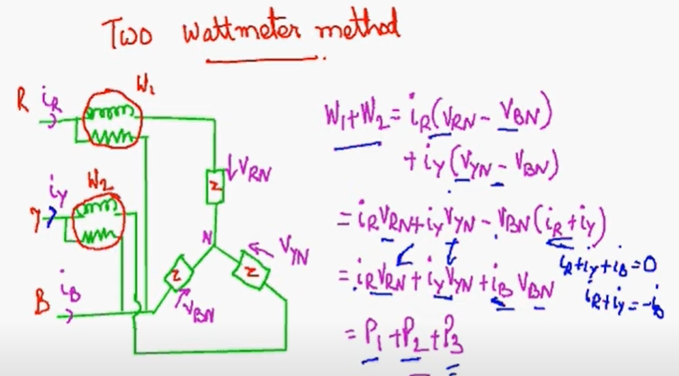

Slide 6
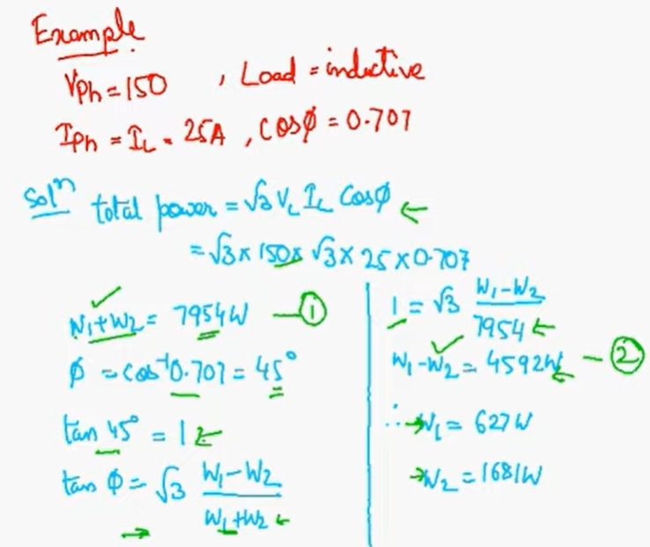

Slide 7
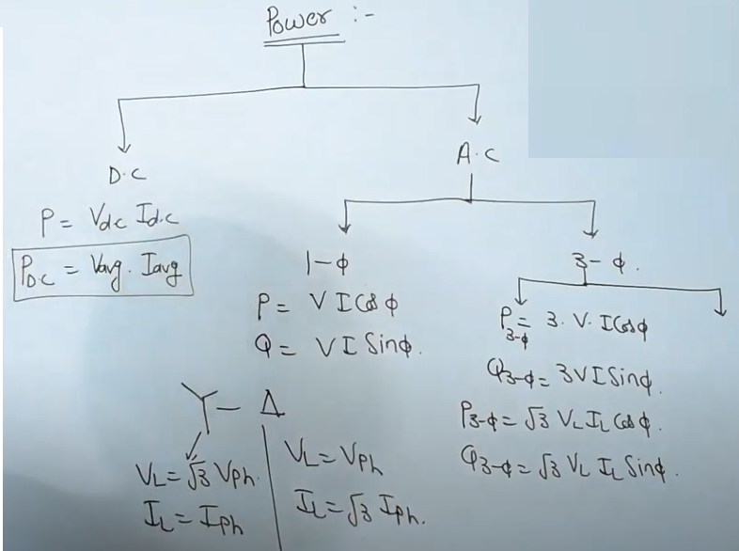
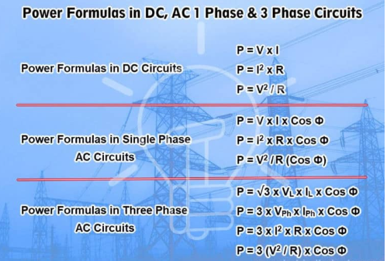
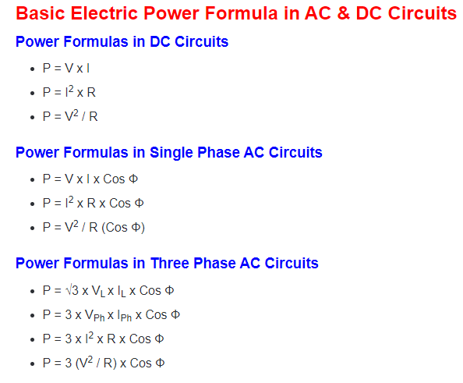

Slide 8








$$v_{AN}= \sqrt{2} V_{p}cosωt$$
$$v_{BN}= \sqrt{2} V_{p}cos⁡(ωt−{120}^{0})$$
$$v_{CN}= \sqrt{2} V_{p}cos⁡(ωt+{120}^{0})$$
$$i_{a}= \sqrt{2} I_{p}cos⁡(ωt−θ)$$
$$i_{b}= \sqrt{2} I_{p}cos⁡(ωt−θ−{120}^{0})$$
$$i_{c}= \sqrt{2} I_{p}cos⁡(ωt−θ+{120}^{0})$$
${p=p}_{a}+p_{b}+p_{c}=v_{AN}$*$i_{a}+ v_{BN}$*$i_{b}+v_{CN}\text{*}i_{c}$
$p=[\sqrt{2} V_{p}cosωt$] *$\left[\sqrt{2}I_{p}\cos\left(ωt−θ\right)\right]+[\sqrt{2}V_{p}\cos\left(ωt−{120}^{0}\right)]$*$\left[\sqrt{2}I_{p}\cos\left(ωt−θ−{120}^{0}\right)\right]+[\sqrt{2}V_{p}\cos\left(ωt+{120}^{0}\right)]$* [$\sqrt{2} I_{p}\cos\left(ωt−θ+{120}^{0}\right)$]
$p=\sqrt{2} V_{p}∗\sqrt{2}I_{p}\{ cosωt$ *$\cos\left(ωt−θ\right)+\cos\left(ωt−{120}^{0}\right)∗\cos\left(ωt−θ−{120}^{0}\right)+\cos\left(ωt+{120}^{0}\right)∗\cos\left(ωt−θ+{120}^{0}\right)\}$
$p=2V_{p}I_{p}\{ cosωt$ *$\cos\left(ωt−θ\right)+\cos\left(ωt−{120}^{0}\right)∗\cos\left(ωt−θ−{120}^{0}\right)+\cos\left(ωt+{120}^{0}\right)∗\cos\left(ωt−θ+{120}^{0}\right)\}$

Slide 9
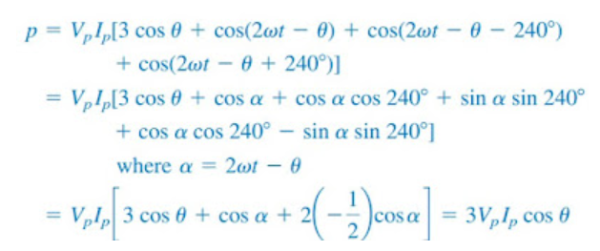
$p=2V_{p}I_{p}\{ cosωt$ *$\cos\left(ωt−θ\right)+\cos\left(ωt−{120}^{0}\right)∗\cos\left(ωt−θ−{120}^{0}\right)+\cos\left(ωt+{120}^{0}\right)∗\cos\left(ωt−θ+{120}^{0}\right)\}$

